Slide 1
Section 3
Ahmed Fayez

Slide 2
A very important consideration in data communications is how fast we can send data, in bits per second, over a channel. Data rate depends on three factors:
1. The bandwidth available
2. The level of the signals we use
3. The quality of the channel (the level of noise)

Slide 3
Channel
Noise
Channel
Capacity
Channel
Capacity
Noiseless
Channel
Noisy
Channel

Slide 4
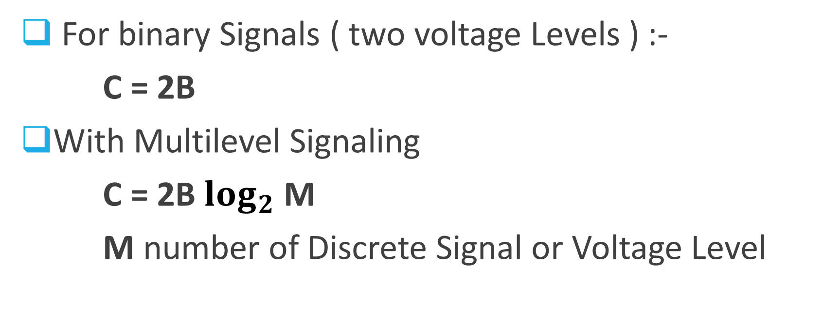
Nyquist Bandwidth
For binary Signals ( two voltage Levels ) :-
C = 2B
With Multilevel Signaling
C = 2B $\log_{2}$ M
M number of Discrete Signal or Voltage Level

Slide 5

Signal-To-Noise Ratio
SNR = $\frac{Signal Power}{Noise Power}$
SNRdB = 10$\log_{10}{SNR}$

Slide 6

Shannon Capacity Formula
C = B $\log_{2}$ ( 1+SNR )

Slide 7
Example
Consider a noiseless channel with a bandwidth of 3000 Hz transmitting a signal with two signal levels. The maximum bit rate can be calculated as ?

Slide 8
Example
Consider the same noiseless channel transmitting a signal with four signal levels. The maximum bit rate can be calculated as

Slide 9

Example
We need to send 280 kbps over a noiseless channel with a bandwidth of 20 kHz. How many signal levels do we need?
280000 = 2 x 20000 x $\log_{2}{L}$
$\log_{2}{L}$ = 7 L= $2^{7}$ = 128 Levels

Slide 10

Example
The Power of a Signal is 10 mW and The Power of The Noise 1 µW What is The Value of SNR , SNRdB ?
SNR = $\frac{Signal Power}{Noise Power}$ = $\frac{10 x {10}^{−3}}{1 x {10}^{−6}}$ = 10000
SNRdB = 10$\log_{10}{10000}$ = 40

Slide 11
Example
Consider an Extremely noise channel in which the Value of The Signal-To-Ratio is Almost Zero In other Words The Noise is So Strong That The Signal Is Faint . For This Channel Find The Capacity?

Slide 12
Example
Calculate The highest Bit Rate of A Regular Telephone Line . A Telephone Line Normally has A Bandwidth 3000 . The Signal-To-Ratio is Usually 3162 Find The Capacity ?

Slide 13
Example
The Signal-To-Ratio Often Given in Decibels assume That SNRdB = 36 and the Channel Bandwidth is 2 MHZ. Find The Channel Capacity ?

